Slide 1
the digital shopping town
retail between
theory and practice
TCM Villach I Austria
Mag. Ines Wiggisser / Mag. (FH) Kathrin Hassler

Slide 2
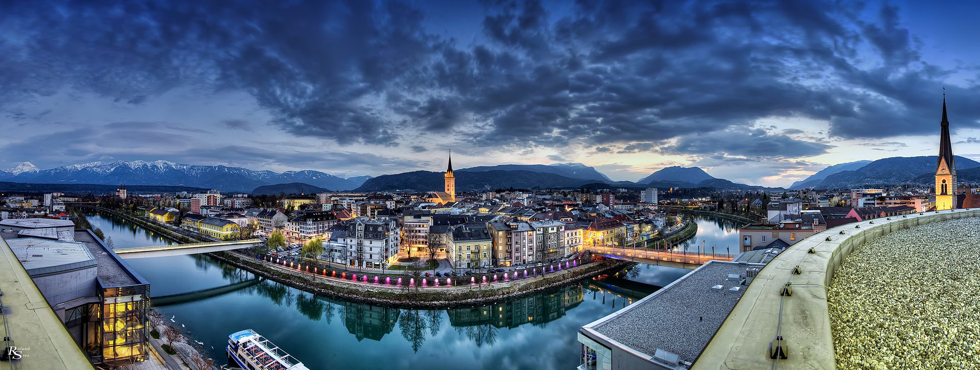
VILLACH
⬇
61.221 inhabitants
⬇
Alpe-Adria-region
⬇
between mountains and lakes
⬇
350 retailers in the city centre
100 gastronomy businesses
KUNDEN-SERVICE
City App
City Box
KUNDEN-BINDUNG
Parkplatzlösungen
Beacons
KAUFKRAFT-STÄRKUNG
City Gutscheincard
Virtuelles Schaufenster
Fashion Cams

Slide 3
CONTENT
⬇
our projects as TCM
⬇
future trends
⬇
experiences in realisation
and working day life
KUNDEN-SERVICE
City App
City Box
KUNDEN-BINDUNG
Parkplatzlösungen
Beacons
KAUFKRAFT-STÄRKUNG
City Gutscheincard
Virtuelles Schaufenster
Fashion Cams

Slide 4
beacons
management field
tourism
commerce
retail
W-LAN
costumer services
fashion
cams
CRM
App
virtual shop window
economy
culture
social action
digital city
public transport
society
mobility
real time information
sports
parking solution
short term parking

Slide 5
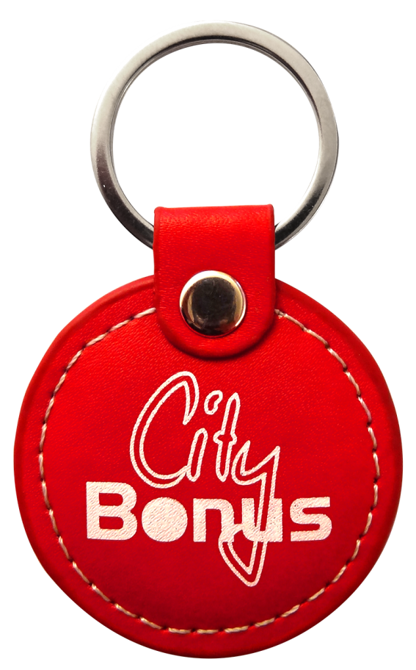
beacons
costumer relation management
tourism
commerce
retail
W-LAN
costumer services
fashion
cams
CRM
App
virtual shop window
economy
culture
social action
digital city
public transport
society
mobility
real time information
sports
parking solution
short term parking

Slide 6
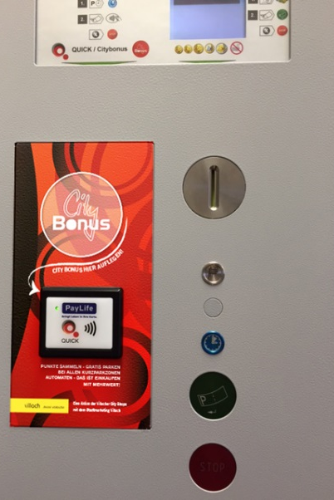
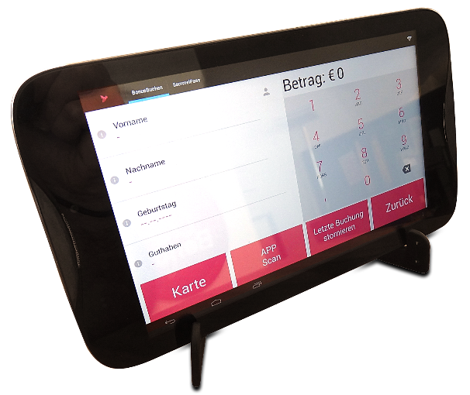
customer relation management
CITY BONUS
parking machines with CITY BONUS function (NFC-Reader)
customer: uses points for free parking
shops: tablets with SIM-card
keyfobs or cards with NFC-chips
data transmission via Internet
expandable system

Slide 7
customer relation management
CITY BONUS
USP = keyfob as supporting medium
shopping, collecting points = free parking
more than 15.000 participants = valuable customer data
> 42 mio. collected BONUS-points – > 34 mio. converted BONUS-points
>118.000 parking hours and € 215.000,- cashed Villach vouchers
Notes:
System besteht seit 2007 / Relaunch 2014/15
Laufende Aktivitäten zur Bewerbung und Anmeldung in den Shops oder online

Slide 8
CRM
CITY BONUS > future trends
vision
mobility card for every inhabitant
extension of acceptence (not just retail)
CRM with NFC chip
inclusion of public transport
CRM with RFID technique
loyality marketing

Slide 9
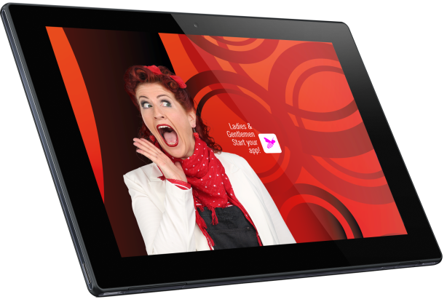
RETAIL DIGITIZATION „TABLETS at the POS“
customer relation management
CITY BONUS
trader information
newstool (SMS)
mobile application
VILLACH CITY APP (collection passport, City Bonus)
local commerce
„search – find - shop!“
mobile application
translation tool
customer service
CITY BOX
vision

Slide 10
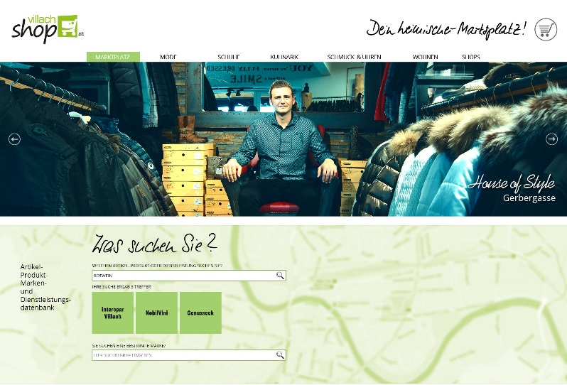
beacons
online shopping
tourism
commerce
retail
W-LAN
costumer services
fashion
cams
CRM
App
virtual shop window
economy
culture
social action
digital city
public transport
society
mobility
real time information
sports
parking solution
short term parking

Slide 11
LOCAL COMMERCE-SOLUTION
VILLACHSHOP
„shop!“
landing page for local onlineshops
„links to all onlineshops“
„find!“
market place for special offers and best sellers from CITY SHOPS
„click and collect“
„search!“
search for articles / product groups /
brands / services
„digital shop window“

Slide 12
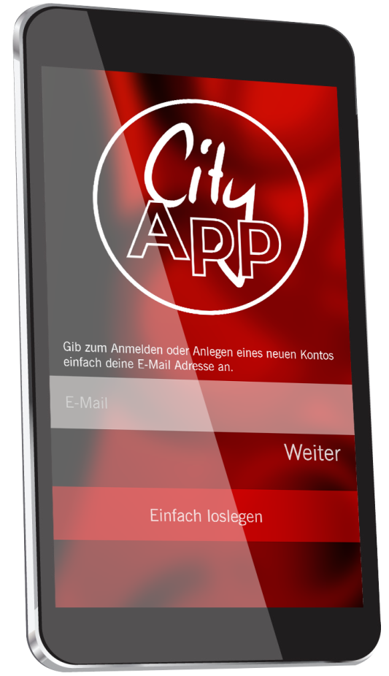
beacons
mobile customer service
tourism
commerce
retail
W-LAN
costumer services
fashion
cams
CRM
App
virtual shop window
economy
culture
social action
digital city
public transport
society
mobility
real time information
sports
parking solution
short term parking

Slide 13
mobile customer service
VILLACH CITY APP
> 2.500 downloads
USP: City BONUS-function
georeferenced shops I contact I opening hours I search for products and brands I gastronomy I business menues I events I customer cards I news I shopping list I flyers I vouchers I collecting passports

Slide 14
mobile customer service
VILLACH CITY APP – future trends
geographical
content
Integration of the peripheral business!
street search
brand finder
article finder
market place & villachshop.at
bus timetable
mobility
parking guidance system
„mobile parking“

Slide 15
beacons
Villach voucher system
tourism
commerce
retail
W-LAN
costumer services
fashion
cams
CRM
App
virtual shop window
economy
culture
social action
digital city
public transport
society
mobility
real time information
sports
parking solution
short term parking

Slide 16
purchasing power programme
VILLACH VOUCHER
local currancy for more than 130 shops and gastronomy business
annual incoming from € 400.000 to € 700.000,-
selling point: TCM Villach + 10 local shops
clearing: TCM Villach with a special software and web application

Slide 17
purchasing power programme
VILLACH VOUCHERCARD
2016:
VOUCHERCARD SOLUTION
(multiple convert options)
benefits:
easy payment via payment terminals
less clearing costs and effort
less bank charges
commitment for major industrial companies

Slide 18
beacons
vision
tourism
commerce
retail
W-LAN
costumer services
fashion
cams
CRM
App
virtual shop window
economy
culture
social action
digital city
public transport
society
mobility
real time information
sports
parking solution
short term parking

Slide 19
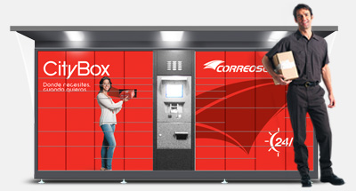
future trends
CITY BOX
Customer services with installation of „City Boxes“
storaging and collecting boxes (paying / opening with the „CITY BONUS“)

Slide 20
BARRIERS for FURTHER DEVELOPMENT…
… are not customers or technique!
IT´S THE INVOLVED PEOPLE!
BARRIER NR. 1)
BARRIER NR. 2)
local politics
TCM responsibles
BARRIER NR. 3)
local enterpreneurs

Slide 21
BARRIER for FURTHER DEVELOPMENT…
„lateral thinking“ instead of safe standardised solutions
learning by doing
LACK OF COURAGE
TO ADRESS NEW TOPICS!
„The world belongs to those who think louder than others shout.“ (unknown)
allow criticism & failure

Slide 22
BARRIER for FURTHER DEVELOPMENT…
„Search for new co-financing sources!“
„there are hardly any computations of return on invest“
LACK OF
WILLINGNESS TO FINANCE!
„Tomorrow belongs to those who can here it coming!“ (David Bowie)
„anticyclical is a foreign word for many responsibles“

Slide 23
BARRIER for FURTHER DEVELOPMENT…
„basic problem of intermediate organisations“
„retailers are still lone fighters“
LACK OF
INTENTION TO COOPERATE!
„voluntary commitment“
„When was the last time you did something for the first time?“

Slide 24
thank you ...

